Slide 1
Getting Started with Azure Kubernetes Service
North Boston Azure , June 2019
Jason Haley

Slide 2
My assumptions about why you are here
You are learning or starting to learn containers, Docker and Kubernetes
You currently are in the process of “containerizing your apps”
You already have microservices and want to move from VM’s to Kubernetes
You are moving to the cloud and want to put all your apps in one location for a single control plane
You have been learning Docker and Kubernetes for awhile and maybe even use AKS but want to hear it again to help things gel

Slide 3
Agenda
Containers and Docker - (optional if we are all familiar)
Kubernetes - (optional if we are all familiar)
Azure Kubernetes Service (AKS)
Helm
Azure DevOps
Visual Studio 2019 Tooling and DevSpaces

Slide 4
Containers and Docker

Slide 5
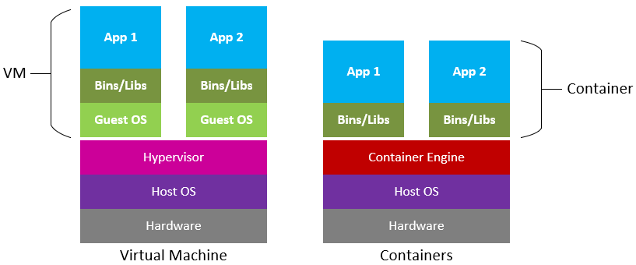
Containers
“Containers are specially encapsulated and secured processes running on the host system” – Dr. Gabriel N Schenker
Notes:
Containerize your Apps with Docker and Kubernetes: Deploy, scale, orchestrate and manage containers with Docker and Kubernetes
(Free eBook): https://azure.microsoft.com/mediahandler/files/resourcefiles/containerize-your-apps-with-docker-and-kubernetes/Containerize_your_Apps_with_Docker_and_Kubernetes.pdf
Container images contain an application’s dependencies and can be run by the container engine isolating it from other applications on the same host. A container engine leverages operating system features like namespaces and cgroups to essentially virtualize the kernel.
Cgroups – provide resource limits
Namespaces – provide isolation for running process
Unlike VMs, containers don’t need their own operating system. This saves system resources and allows more applications to be run on the same host – than separate VMs would.

Slide 6
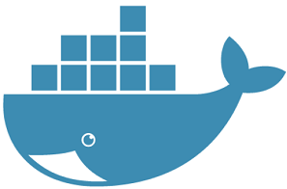
Docker
Containers have been possible long before Docker
Docker the technology revolutionized containers
Are portable and can run on Linux, Windows and Mac
Open Container Initiative (OCI)
Runtime-spec
Image-spec
Notes:
Docker makes it easy to build and run containers
https://www.docker.com/community/open-source
https://mobyproject.org/
https://github.com/moby/moby
https://containerd.io/
https://github.com/containerd/containerd
https://www.opencontainers.org/

Slide 7
Container Registries
A repository to store container images
Public or Private
DockerHub
https://hub.docker.com
Azure Container Registry
https://azure.microsoft.com/en-us/services/container-registry/

Slide 8
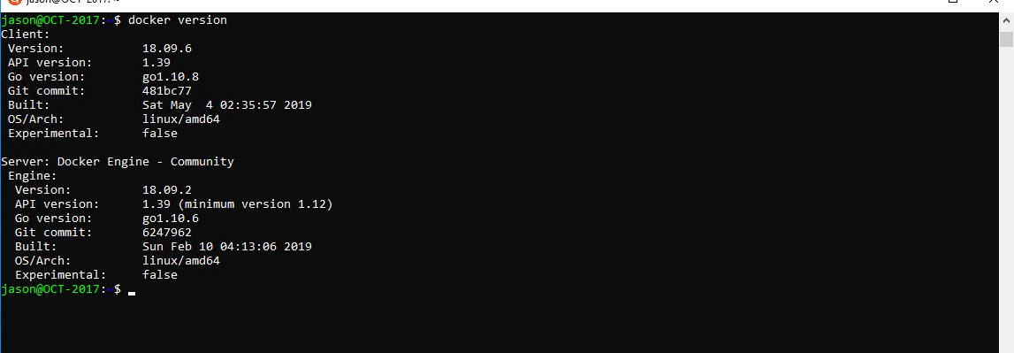
Demo
Create a Docker container image
Notes:
https://weblog.west-wind.com/posts/2017/apr/13/running-net-core-apps-under-windows-subsystem-for-linux-bash-for-windows
https://nickjanetakis.com/blog/setting-up-docker-for-windows-and-wsl-to-work-flawlessly
Quick Intro to commons commands
Use an existing image from docker hub
Build an image and run it locally

Slide 9
Resources
What is a container really? Let’s write one in Go from scratch, Liz Rice (https://www.youtube.com/watch?v=HPuvDm8IC-4) Short 23 min video that explains the concept in practical terms
Containerize your Apps with Docker and Kubernetes, Dr. Gabriel N. Schenker (https://azure.microsoft.com/mediahandler/files/resourcefiles/containerize-your-apps-with-docker-and-kubernetes/Containerize_your_Apps_with_Docker_and_Kubernetes.pdf) Free 300 page eBook – highly recommended
Learn Docker & Containers using Interactive Browser-Based Scenarios (https://www.katacoda.com/courses/docker) – ~20 hands on scenarios to walk you through the basics

Slide 10
Kubernetes

Slide 11
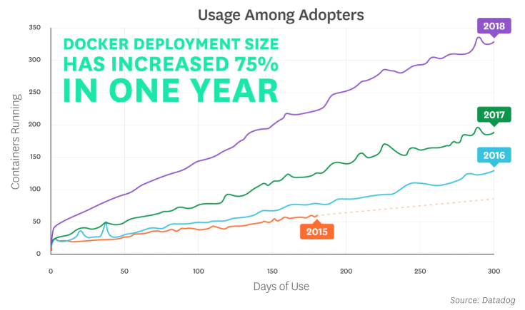
Average Size of Docker Deployment
https://www.datadoghq.com/docker-adoption/
Notes:
https://www.datadoghq.com/docker-adoption/

Slide 12
Container Orchestrators
Clustering technology of container hosts
Help manage lifecycles of containers
Provide high availability and load balancing
Health monitoring
Provide networking and communication in/out of cluster

Slide 13
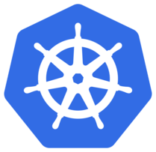
Kubernetes
Compute scheduling
Self-healing
Service discovery & load balancing
Horizontal scaling
Automated rollouts & rollbacks
Volume management
Secret & configuration management
Notes:
Compute scheduling—It considers the resource needs of your containers, to find the right place to run them automatically
Self-healing—If a container crashes, a new one will be created to replace it.
Service discovery & load balancing—IP address, DNS, and multiple instances are load-balanced.
Horizontal scaling—By observing CPU or custom metrics, Kubernetes can add and remove instances as needed.
Automated rollouts & rollbacks–During updates, the health of your new instances are monitored, and if a failure occurs, it can roll back to the previous version automatically.
Volume management—It manages the persistent storage used by your applications
Secret & configuration management. It manages application configuration and secrets.

Slide 14
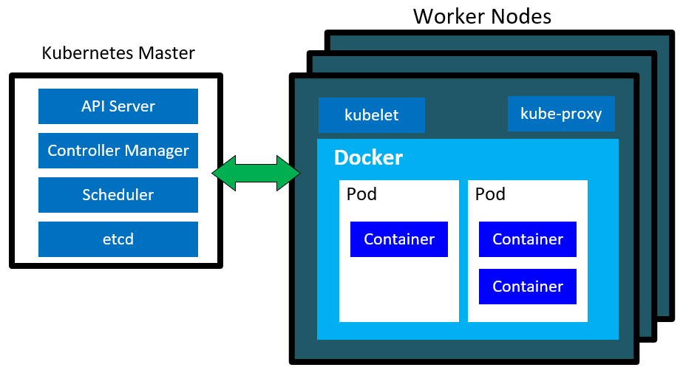
Architecture
Notes:
Kubernetes Master Components (aka Control Plane)
API server—exposes the Kubernetes API for controlling the cluster
Controller manager—responsible for watching the cluster’s objects and resources and ensuring the desired state is consistent
Scheduler—responsible for scheduling compute requests on the cluster
etcd—an open-source distributed key value store used to hold the cluster data
Node Components
Kubelet—responsible for communicating to the master and ensuring the containers are running on the node
Kube-proxy—enables the cluster to forward traffic to executing containers
Docker (container runtime)—provides the runtime environment for containers
Pod – the basic execution unit. Contains one or more containers that run your application

Slide 15
A Few Common Kubernetes Objects
Pod
The basic execution unit. Contains one or more containers that run your application
Deployment
Uses a ReplicaSet to keep the desired state of your number of pods running and provides ability to perform rolling updates
Service
A layer above a set of pods used to expose them on a network. The related pods are defined by a label selector
Ingress
Manages external access to the services in a cluster using rules.
Notes:
Should add Ingress

Slide 16
Controllers
ReplicaSet
Deployment
StatefulSet
DaemonSet
Job
CronJob
Notes:
Controllers take care of routine tasks that ensure the desired state of the system meets the actual state of the system.
ReplicaSet – used for maintaining a number of pods running at any give time to ensure desired state
Deployment – extends a ReplicaSet with rollback capability
StatefulSet – like a ReplicaSet but provides ordering and uniqueness of pods
DaemonSet – ensures that all nodes run a copy of a pod
Job – run pods and terminate
CronJob – jobs that run on a time-based schedule
I didn’t mention ReplicationController – since ReplicaSets were designed to replace them.
https://kubernetes.io/docs/concepts/workloads/controllers/statefulset/

Slide 17
Other common terms
Namespace
Service
Ingress
ConfigMap
Secret
Notes:
Namespace – a virtual cluster backed by the same physical cluster, allows you to isolate resources
Service – a layer above a set of pods used to expose them on a network
Ingress – manages external access to the services in a cluster
ConfigMap – allow you to decouple configuration artifact from image content. Store configuration
Secret – let you store and manage sensitive information. Pods have to reference the secret. Secrets be used by a pod or by kubelet. Can be mounted as volume or exposed as environment variable

Slide 18
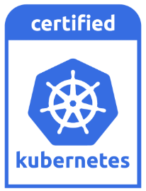
Kubernetes Conformance
Consistent implementations
Portability of your applications
https://github.com/cncf/k8s-conformance

Slide 19
Docker for Desktop has Kubernetes
Free non cloud implementation of Kubernetes
Single node
Great place to start
Notes:
https://devkimchi.com/2018/06/05/running-kubernetes-on-wsl/

Slide 20
Resources
Introduction to Microservices, Docker and Kubernetes, James Quigley (https://www.youtube.com/watch?v=1xo-0gCVhTU) - 55 min video that covers more information than I can cover today to help get started with the concepts.
Kubernetes Deconstructed, Carson Anderson (https://vimeo.com/245778144/4d1d597c5e) - 52 min video that covers how Kubernetes works. Great to watch after you have started learning.
Kubernetes Learning Path (https://azure.microsoft.com/en-us/resources/kubernetes-learning-path/) ~20 page pdf that gives you multiple steps to get hands on with Kubernetes including videos, eBooks and documentation
Notes:
Cloud Native DevOps with Kubernetes, John Arundel - Good book on practical learning of Kubernetes
Tutorials: https://kubernetes.io/docs/tutorials/ and https://www.katacoda.com/courses/kubernetes

Slide 21
Azure Kubernetes Service

Slide 22
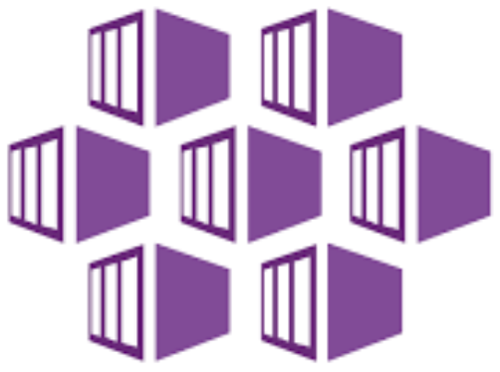
Azure Kubernetes Service (AKS)
Fully managed Kubernetes Service
Microsoft sets up and manages control plan (Kubernetes master)
Only pay for the worker nodes and other Azure resources used
Easily scalable – even has virtual nodes
CNCF certified as Kubernetes conformant
Notes:
https://docs.microsoft.com/en-us/azure/aks/intro-kubernetes

Slide 23
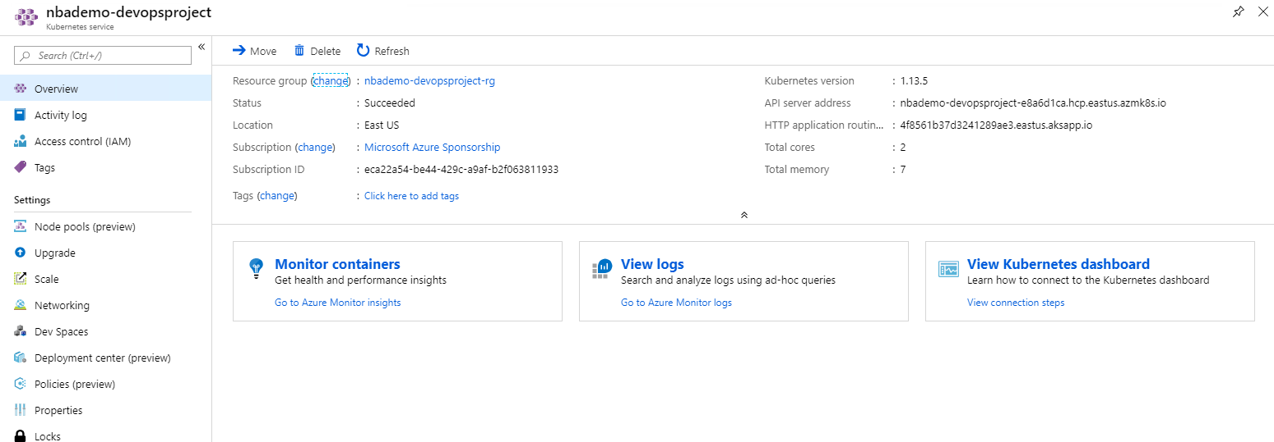
Demo
Create an AKS cluster
Notes:
Great reference for this demo: A Crash Course in Kubernetes on Azure https://www.wintellect.com/a-crash-course-in-kubernetes-on-azure/
https://docs.microsoft.com/en-us/azure/aks/kubernetes-walkthrough
Use portal – won’t have time to create for demos, but can walk through the UI
Takes about 8 minutes to create via UI
Basics page
Subscription
Resource Group
Cluster Name
Region
Kubernetes Version
DNS name prefix – used to connect to the Kubernetes API to manage the cluster
Primary Node Pool Node size – aka VM Size for nodes (can’t change the node size afterwards) – but you can add additional node pools https://docs.microsoft.com/en-us/azure/aks/use-multiple-node-pools
Node count – can do 1 and can change afterwards
Scale page
Virtual nodes – enabled or not - https://docs.microsoft.com/en-us/azure/aks/virtual-nodes-portal
VM Scale sets (preview) – enabled or not have to enable the VMSPreview flags on subscription - https://docs.microsoft.com/en-us/azure/aks/use-multiple-node-pools
Authentication
Service principal – used by the cluster to manage/access azure resources - https://docs.microsoft.com/en-us/azure/aks/kubernetes-service-principal
Enable RBAC – kubernetes authz
Networking
Basic networking (kubenet) – defaults most things for you and hard to change afterwards
Advanced (Azure CNI)– allows you to put in existing VNET and/or configure the Vnet features
Http Application routing - The HTTP application routing solution makes it easy to access applications that are deployed to your cluster by creating publicly accessible DNS names for application endpoints. This will create a DNS zone in your subscription. HTTP application routing is designed for easily getting started with ingress controllers and as such is not recommended for production clusters. https://docs.microsoft.com/en-us/azure/aks/http-application-routing (This add-on is not recommended for production use.)
Monitoring
Container monitoring – gives you cpu and memory usage metrics – very useful
Log Anaylitics workspace – stores the monitoring data

Slide 24
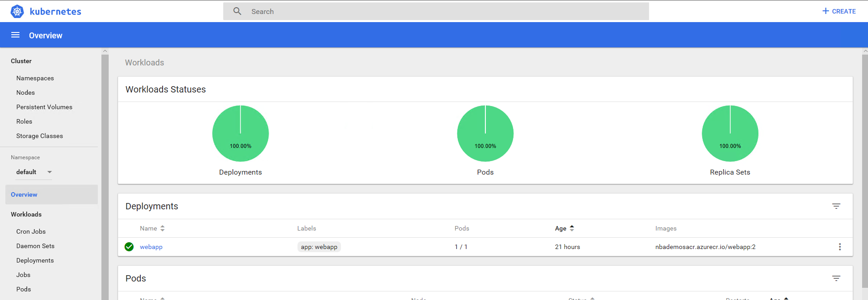
Demo
A look at the Kubernetes dashboard
Notes:
az aks browse --resource-group myResourceGroup --name myAKSCluster
kubectl create clusterrolebinding kubernetes-dashboard --clusterrole=cluster-admin --serviceaccount=kube-system:kubernetes-dashboard
https://docs.microsoft.com/en-us/azure/aks/kubernetes-dashboard

Slide 25
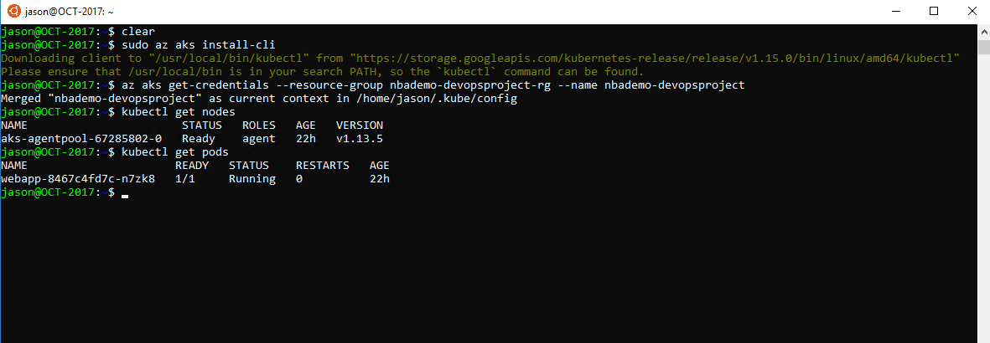
Demo
Setup environment for using kubectl
Notes:
https://docs.microsoft.com/en-us/azure/aks/kubernetes-walkthrough
az aks install-cli
az aks get-credentials --resource-group myResourceGroup --name myAKSCluster
kiubectl get cluster-info
kubectl get nodes
kubectl get pods –all-namespaces
Get the credential

Slide 26
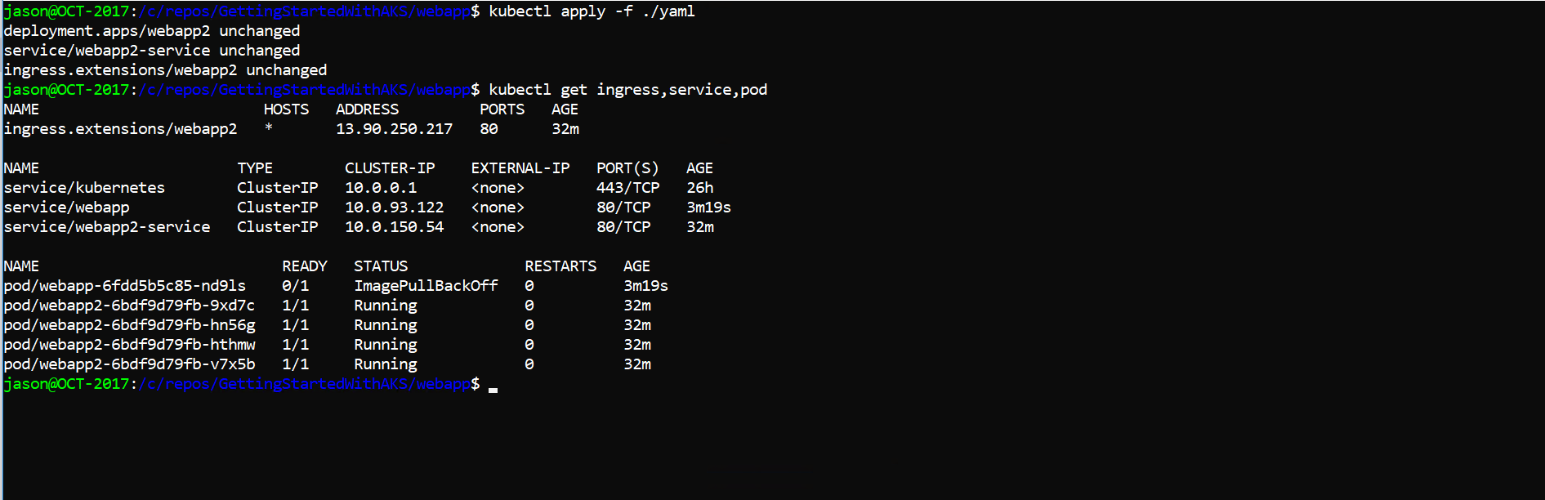
Demo
Deploying an application using kubectl
Notes:
https://docs.microsoft.com/en-us/azure/aks/kubernetes-walkthrough
https://docs.microsoft.com/en-us/azure/container-registry/container-registry-auth-aks
kubectl apply -f azure-vote.yaml
kubectl get service azure-vote-front –watch
az group delete --name myResourceGroup --yes --no-wait
Declarative (yaml) vs. imperative (cli args)
Push the docker image to the ACR, run from az command at root of project
az acr build --registry nbademosacr --image webapp2:latest
Show the yaml
Use kubectl apply –f <file> to deploy to the cluster
kubectl get all
Use kubectl apply –f ingress.yaml to deploy the ingress
https://docs.microsoft.com/en-us/azure/aks/ingress-tls

Slide 27
Resources
Fundamentals of Kubernetes on Microsoft Azure and the road ahead, Build2019 https://mybuild.techcommunity.microsoft.com/sessions/77059?source=sessions
Quickstart: Deploy an Azure Kubernetes Service using Azure CLI https://docs.microsoft.com/en-us/azure/aks/kubernetes-walkthrough
The Azure Kubernetes Workshop (https://aksworkshop.io/) – really good to get hands on walk through experience with AKS
Notes:
https://docs.microsoft.com/en-us/azure/aks/tutorial-kubernetes-prepare-app
https://docs.microsoft.com/en-us/azure/aks/tutorial-kubernetes-prepare-acr
https://docs.microsoft.com/en-us/azure/aks/tutorial-kubernetes-deploy-cluster
https://docs.microsoft.com/en-us/azure/aks/tutorial-kubernetes-deploy-application
https://docs.microsoft.com/en-us/azure/aks/tutorial-kubernetes-scale
https://docs.microsoft.com/en-us/azure/aks/tutorial-kubernetes-app-update
https://docs.microsoft.com/en-us/azure/aks/tutorial-kubernetes-upgrade-cluster

Slide 28
Helm

Slide 29

Helm
The Kubernetes Package Manager
Charts are the “package” used to install Kubernetes applications
Many existing charts:
https://github.com/helm/charts
https://hub.helm.sh/
Great for using it as a templating engine for your applications

Slide 30
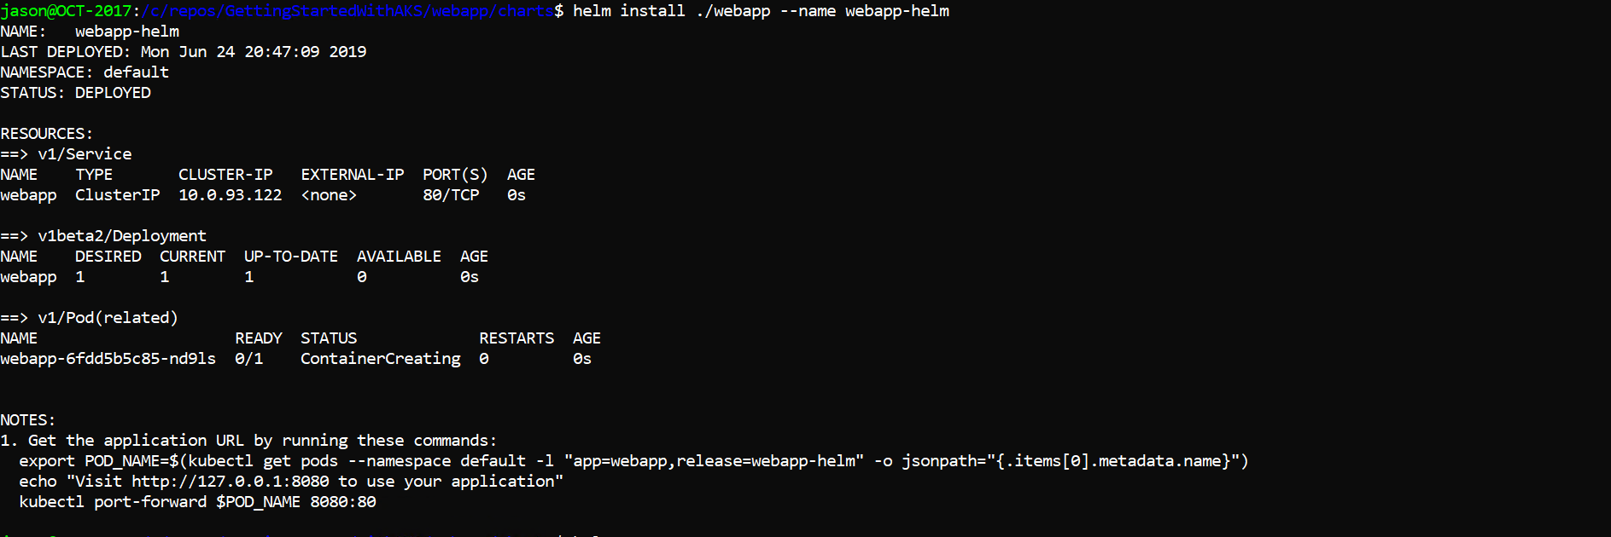
Demo
Use helm chart to deploy an application
Notes:
Show Helm chart
Init helm
Run kubectl delete –f <file>
kubectl get all
Install app using chart
Kubectl get all

Slide 31
Resources
Helm Chart Patterns, Vic Iglesias 28 min video that walks through intro and useful Helm patterns and usage
Quickstart Guide: https://helm.sh/docs/using_helm/#quickstart
The Chart Template Developer’s Guide: https://helm.sh/docs/chart_template_guide/#the-chart-template-developer-s-guide

Slide 32
Azure DevOps

Slide 33

Azure DevOps
DevOps services
CI – Continuous Integration (ie. build)
CD – Continuous Deployment (ie. release)

Slide 34
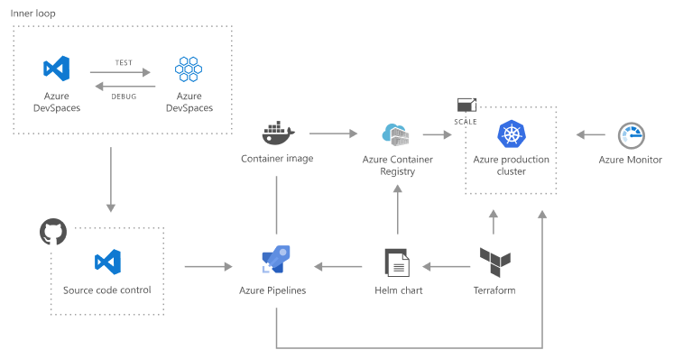
DevOps for Containerize Applications

Slide 35
Options for AKS
Task using Kubectl
Task using Helm
New YAML CI/CD deployments (for Kubernetes)
Notes:
YAML CI/CD and Kubernetes Deployments (video from Build 2019)
https://mybuild.techcommunity.microsoft.com/sessions/77569?source=sessions#top-anchor

Slide 36
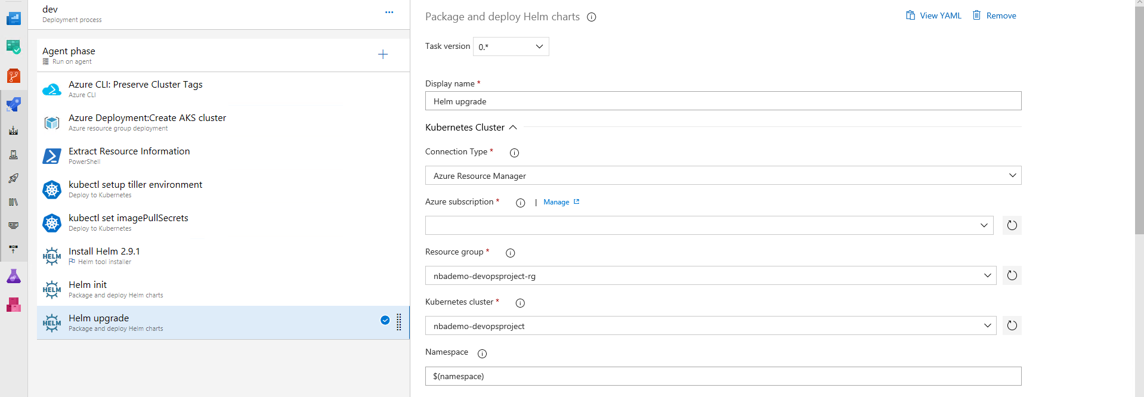
Demo
Walk though a DevOps pipeline
Notes:
Kubectl – walk through going straight to cluster instead of using helm
Helm – walk through creation of DevOps project
YAML CI/CD for Kubernetes – walk through new workflow

Slide 37
Resources
YAML CI/CD and Kubernetes Deployments, Build 2019 https://mybuild.techcommunity.microsoft.com/sessions/77569
Deploy to Kubernetes task (kubectl): https://docs.microsoft.com/en-us/azure/devops/pipelines/tasks/deploy/kubernetes?view=azure-devops
Package and Deploy Helm Charts task: https://docs.microsoft.com/en-us/azure/devops/pipelines/tasks/deploy/helm-deploy?view=azure-devops

Slide 38
Visual Studio 2019 Tooling and DevSpaces

Slide 39
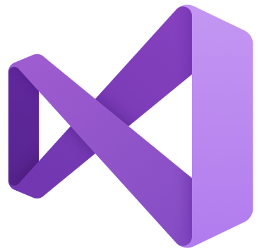
Visual Studio 2019
Docker Support
Kubernetes (as orchestrator)
New Kubernetes Application project type
Visual Studio Container Tools Extension (preview):
https://marketplace.visualstudio.com/items?itemName=ms-azuretools.vs-containers-tools-extensions

Slide 40
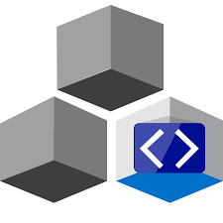
DevSpaces
Returns stdout and stderr from your application running in AKS
Uses port-forward to allow web access using http://localhost
Attaches debugger to your application running in AKS
Syncs source code to your dev space in AKS
Has to be installed on your cluster
Does modify environment
Notes:
https://docs.microsoft.com/en-us/azure/dev-spaces/about
https://docs.microsoft.com/en-us/azure/dev-spaces/how-dev-spaces-works

Slide 41
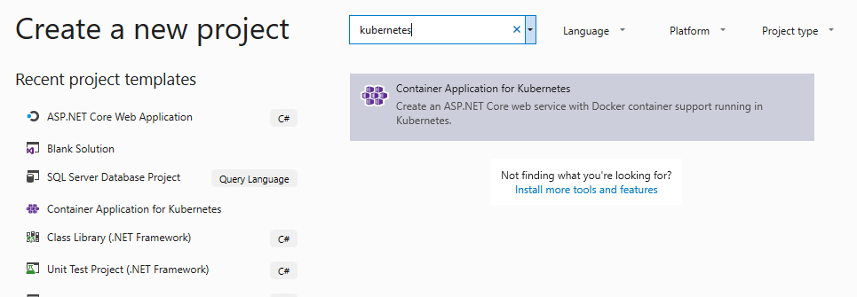
Demo
A look at VS 2019 tooling and DevSpaces
Notes:
https://marketplace.visualstudio.com/items?itemName=ms-azuretools.vs-containers-tools-extensions
https://docs.microsoft.com/en-us/azure/dev-spaces/quickstart-netcore-visualstudio

Slide 42
Resources
Uniting all containers and Kubernetes fans, VS 2019 Launch: https://channel9.msdn.com/Events/Visual-Studio/Visual-Studio-2019-Launch-Event/Uniting-all-containers-and-Kubernetes-fans-in-this-Visual-Studio-2019-session
How Azure Dev Spaces works and is configured: https://docs.microsoft.com/en-us/azure/dev-spaces/how-dev-spaces-works
End to end application development and DevOps on Azure Kubernetes Service, Build 2019 https://mybuild.techcommunity.microsoft.com/sessions/77060

